Slide 1
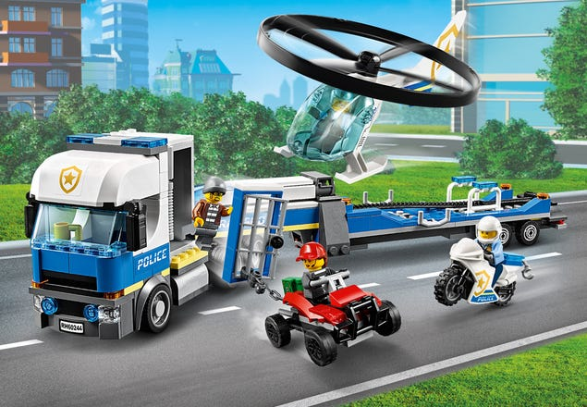
LEGO GROUP

Slide 2
BACKGROUND INFORMATION
The company was founded in 1932 and has specialised in making of toys since its inception.
It has been famous for its LEGO bricks which has been named twice as the toy of the century
It’s currently managed by 6 board members and 9 executive members
Current milestones in the company include online stores for its toys and web based games

Slide 3
Industry
The company operates in the entertainment industry with a bias in the toys and games industry. The industry is very competitive but LEGO Group has been able to shine through.
The company has developed to be a key player especially with the development of the brick technology though it failed to secure the technology completely.
It has however faced key competition from related companies like,
Mattel inc
Hasbro Inc
Tyco toys
Mega blocks
Best block company
The company however seems performing better in financial terms and will most likely outperform or even hedge out some competitors from the market.

Slide 4
Company Performance
LEGO
 | 2019 | 2018 | 2017 | 2016
Gross margin | 72.00 | 71.40 | 70.70 | 72.20
Operating margin | 28.10 | 29.60 | 29.60 | 32.80
Net profit margin | 21.50 | 22.20 | 22.30 | 24.90
Return on equity | 37.80 | 38.00 | 38.30 | 49.90
Return on invested capital | 69.00 | 78.90 | 72.30 | 92.00
Equity ratio | 63.50 | 69.10 | 69.30 | 66.90
Current ratio | 1.93 | 2.06 | 2.04 | 1.99
MATTEL INC
Gross margin |  | 39.80 | 37.40 | 46.70
Operating margin |  | - 5.20 | - 6.90 | 9.50
Net profit margin |  | - 11.80 | - 21.60 | 5.70
Return on equity |  | - 81.20 | - 84.60 | 13.00
Return on invested capital |  | - 13.40 | - 22.90 | 6.30
Equity ratio |  | 12.30 | 20.00 | 37.10
Current ratio |  | 1.86 | 1.91 | 1.95
HASBRO INC
Gross margin |  | 59.60 | 60.90 | 62.10
Operating margin |  | 7.20 | 15.60 | 15.70
Net profit margin |  | 4.80 | 7.60 | 10.60
Return on equity |  | 12.60 | 21.60 | 28.60
Return on invested capital |  | 4.20 | 7.50 | 10.50
Equity ratio |  | 33.30 | 34.60 | 36.60
Current ratio |  | 0.87 | 1.05 | 1.02

Slide 5
Company Performance, Continued…….
From the company financial performance, the following is evident;
The company has a good profit margin compared to its competitors which shows a low cost of production
The company has a high equity ratio which shows a lower probability of liquidation
The company has a good return on equity which improves on its corporate image
The company generally outperforms its key competitors in these financial insights which are very key as they show the exact company performance and has an indication of the future state of affaires in the company.

Slide 6
Company Strategies
The company has the following strategies in place which are geared at making it stand out of the competition
Tax strategy – Increases compliance wherever it operates
Dividend strategies – They ensure excess liquidity is distributed to share holders. This has a positive impact on share prices
Focus on online stores – This improves sales while cutting down on logistics costs
Advanced web based games – To boost sales and reduce costs of operation
The company should – as a way of gaining more market share- adopt the following strategies;
Acquisition of loss making companies like Mattel Inc
Advance more in the entertainment industry beyond toys and games
Seek franchises in the untapped markets to boost sales
Seek opportunities for foreign direct investments to reduce operational costs while gaining confidence in the locality

Slide 7
SWOT Analysis
Company strengths
Lower cost of production as shown by a high gross profit margin
Sufficient liquidity as shown by the current ratio
Technology advancement
Online stores
Experienced and diverse board of directors
Company Weaknesses
Failure in making universal web based games – Leading to some restrictions limiting sales.
Focusing on a single industry - This limits risk cushioning offered by portfolios.

Slide 8
SWOT Analysis, Continued…….
Opportunities
Growing markets
Online games potential
Parents becoming more enlightened on usefulness of toys in learning
Games and toys for adults
Educative toys which may be more preferred by parents
Threats
Growing competition
Effect of cybercrime to their web based games
Fast changing environments which may make games obsolete within a short period of time
Globalization which speeds up destructive effect on businesses in case of a crisis in one part of the world.

Slide 9
Future of LEGO Group
The company appears very strategic in nature compared to its competitors.
Based on the company SWOT analysis, the following is very likely about LEGO Group;
Increased market share due to move to new markets and web based games
Good returns to shareholders improving the company market share
The company is also likely to takeover other firms with negative returns in the industry like Mattel Inc
The company may venture fully in the entertainment industry beyond toys to boost revenues

